Slide 1

Emotion Recognition from Speech Using Machine Learning

Slide 2
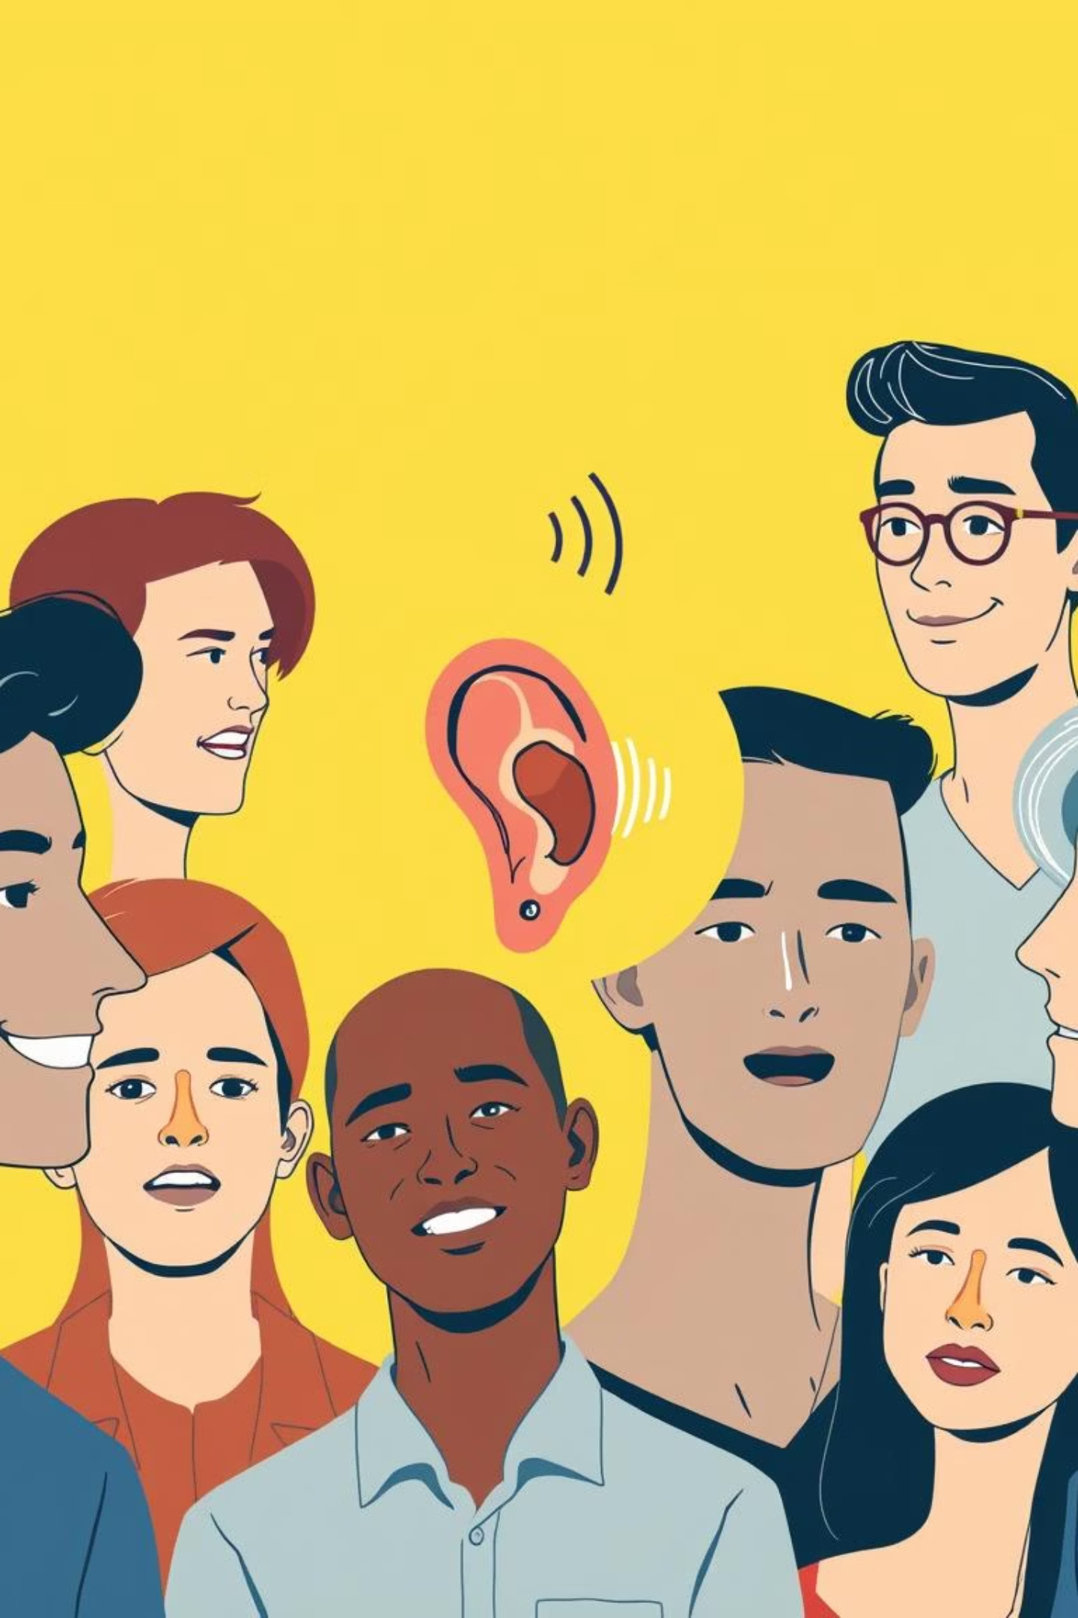
Why Emotion Recognition from Speech Matters
Understanding Human Communication
Enhancing Applications
Automatic recognition revolutionizes healthcare, customer service, and human-computer interaction by adding emotional intelligence.
Emotions like happy, sad, angry, and neutral are fundamental to human interaction and social intelligence.
The Subtlety Challenge
Emotions are complex, nuanced, and vary widely across individuals and contexts, posing a significant challenge for AI.

Slide 3
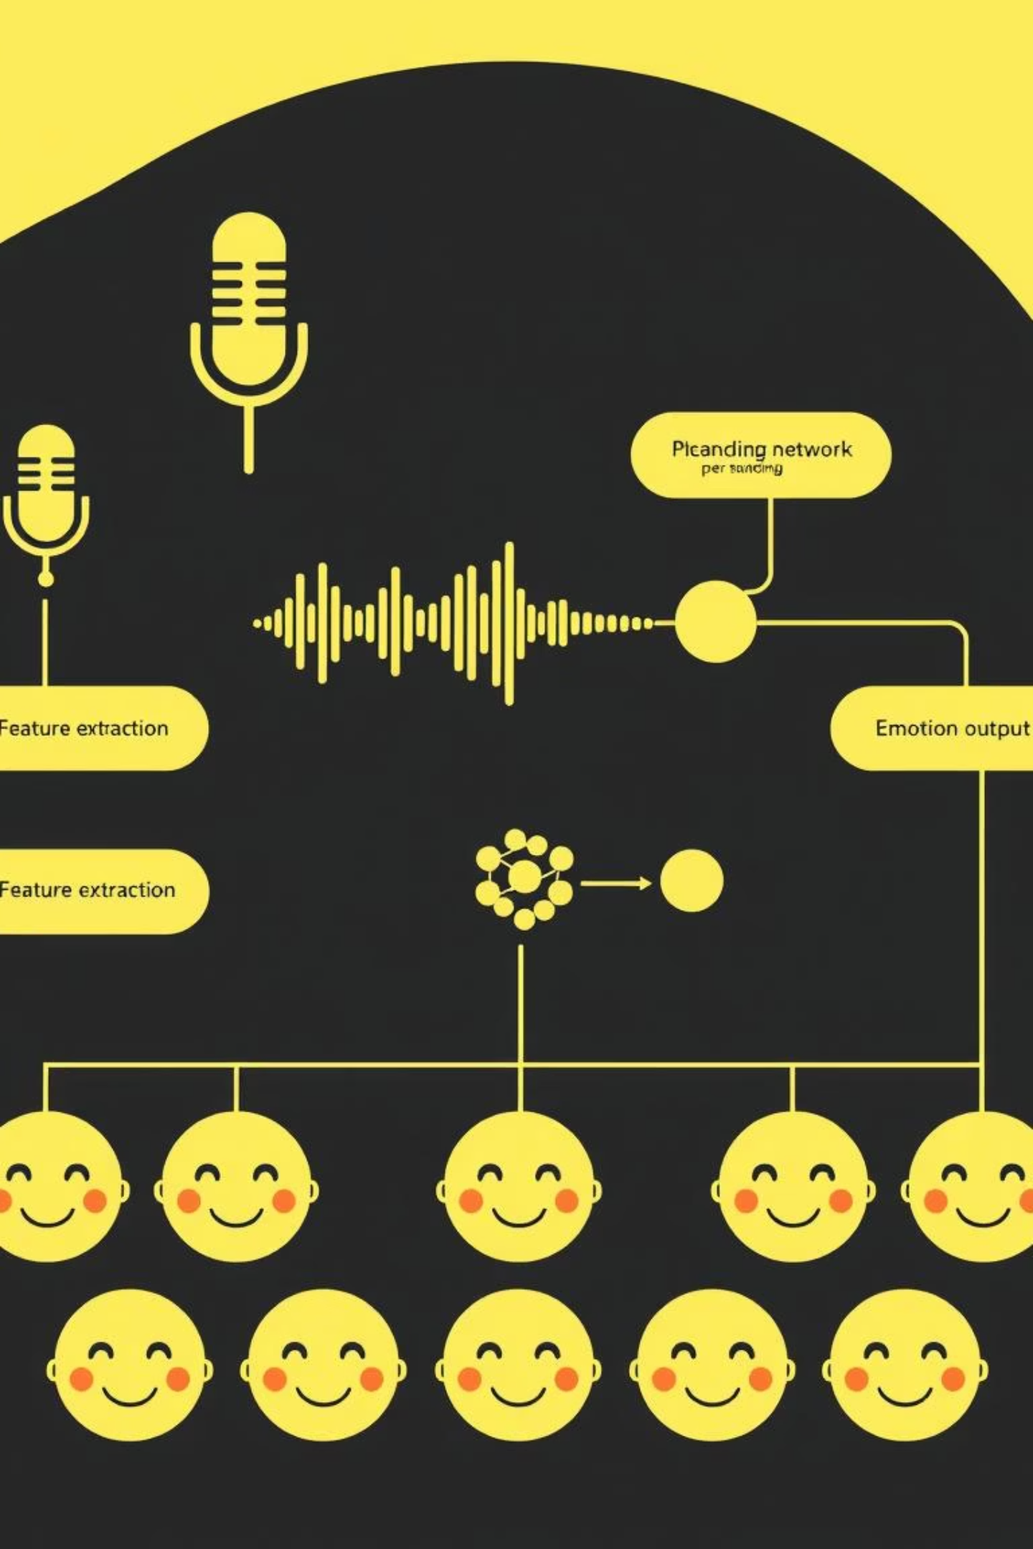
Workflow Overview: From Audio to Emotion Prediction
01
Feature Extraction
Utilize Librosa for audio preprocessing and robust MFCC feature extraction.
02
Dataset Preparation
Curate and label datasets with emotions: happy, sad, angry, and neutral speech samples.
03
Model Building & Training
Develop and train deep learning models (CNN/RNN) using TensorFlow/Keras powerful framework.
04
Evaluation & Testing
Assess model performance using accuracy metrics, confusion matrices, and real-time inference.

Slide 4

Key Audio Features: Mel-Frequency Cepstral Coefficients (MFCC)
MFCCs are the cornerstone of speech emotion recognition, adept at capturing the unique timbral qualities of a voice. They closely mimic how the human ear processes sound, making them highly effective for extracting emotional cues from speech.
They summarize the short-term power spectrum of sound, distilling complex audio into manageable features.
Their robustness makes them a widely adopted feature extraction method in the field.
Think of MFCCs as the "fingerprint" of a spoken emotion.

Slide 5
MFCC Steps:
1)SOUND
2)MFCSS
3)1D CNN
4)Softmax
Raw Audio: Computer Cant understand due to background noise, volume difference etc
MEL: Tells computer to pay close attention to to low freq and ignore content in high freq
A) Framing: Long audio 20 to 40 ms slice. Constant change in voice so analyze ms by ms
B) Windowing: Smooth Edges of slice by applying math function
C) FFT: Transform sound wave into list of frequency ( Low med High)
D) MEL Filter Bank: Ignore Frequncy By mel scale
E) Logrithmm: human hear volume logarithmically so take log of data to match perception
F) Discrete cosine transform compress data and remove correlated information

Slide 6
Feature Normalization and Standardization
When we train deep learning models on audio, the model expects every input to be the same length. But real audio clips don’t behave they come in all shapes and sizes. So we guide them into shape using two simple tricks:
1. Fixed Length
Our model needs every MFCC feature sequence to have exactly 174 time steps. Think of it like every student turning in a paper with a strict page limit.
2. Zero-Padding (for short audio)
If an audio clip doesn’t have enough time steps, we add zeros at the end until it reaches 174. It’s like slipping blank pages at the back of a too-short assignment so it meets the required length—only here, it’s totally allowed.
3. Truncation (for long audio)
If the audio is too long, we simply cut off the extra time steps after 174.

Slide 7
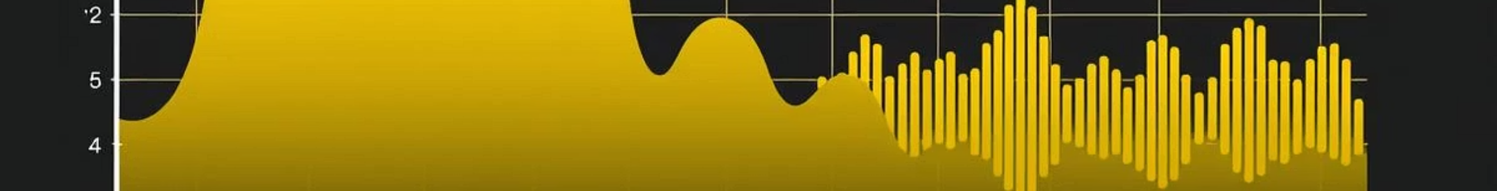
Code Snippet:
This section provides a placeholder for the Python code demonstrating Librosa's use for extracting MFCC features from an audio file. The output will showcase a visual representation of these features.
import librosa import soundfile as sf import numpy as np import pandas as pd from sklearn.model_selection import train_test_split import tensorflow as tf from tensorflow import keras from tensorflow.keras import layers import gradio as gr import joblib from google.colab import files import os from sklearn.preprocessing import LabelEncoder from tensorflow.keras.utils import to_categorical from tensorflow.keras.models import Sequential from tensorflow.keras.callbacks import EarlyStopping, ModelCheckpoint from tensorflow.keras.layers import Conv1D,MaxPooling1D,Flatten,Dense,Dropout,BatchNormalization | !pip install kaggle #install Kaggle #uwrfkaggler/ravdess-emotional-speech-audio files.upload() #upload kaggle file !mkdir ~/.kaggle #making folder of kaggle !cp kaggle.json ~/.kaggle/ # copying the file !mkdir -p ~/.kaggle !mv kaggle.json ~/.kaggle/ !chmod 600 ~/.kaggle/kaggle.json !kaggle datasets download -d uwrfkaggler/ravdess-emotional-speech-audio !pip install librosa soundfile numpy pandas scikit-learn tensorflow gradio joblib

Slide 8
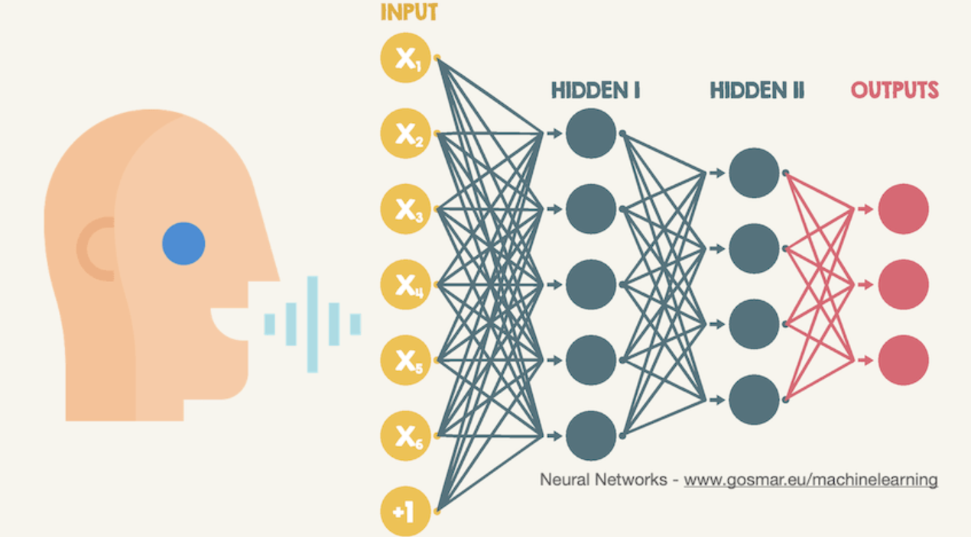



Deep Learning Architectures
for Emotion Classification
CNNs
Excel at extracting spatial patterns from spectrograms, like identifying key frequency bands.
RNNs
Capture temporal dependencies, understanding how emotional expression evolves over time.
Hybrid Models
Combine the strengths of both CNNs and RNNs for superior accuracy in complex emotional landscapes.

Slide 9
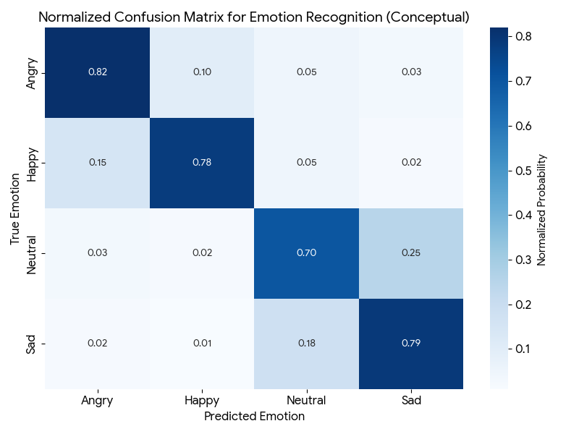
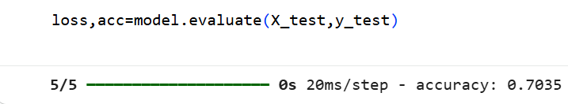
Code Snippet: TensorFlow/Keras Model Architecture
This placeholder is for the Python code defining a sample CNN or RNN model architecture in PyTorch, suitable for speech emotion recognition. It will typically include convolutional layers, pooling layers, and recurrent layers if applicable, followed by fully connected layers.
#CNN MODEL model = Sequential([ Conv1D(64, 5, activation='relu', input_shape=(max_pad_len, N_MFCC)), BatchNormalization(), MaxPooling1D(2), Dropout(0.3), Conv1D(128, 5, activation='relu'), BatchNormalization(), MaxPooling1D(2), Dropout(0.3), Flatten(), Dense(128, activation='relu'), Dropout(0.4), Dense(y_onehot.shape[1], activation='softmax') ])
.

Slide 10
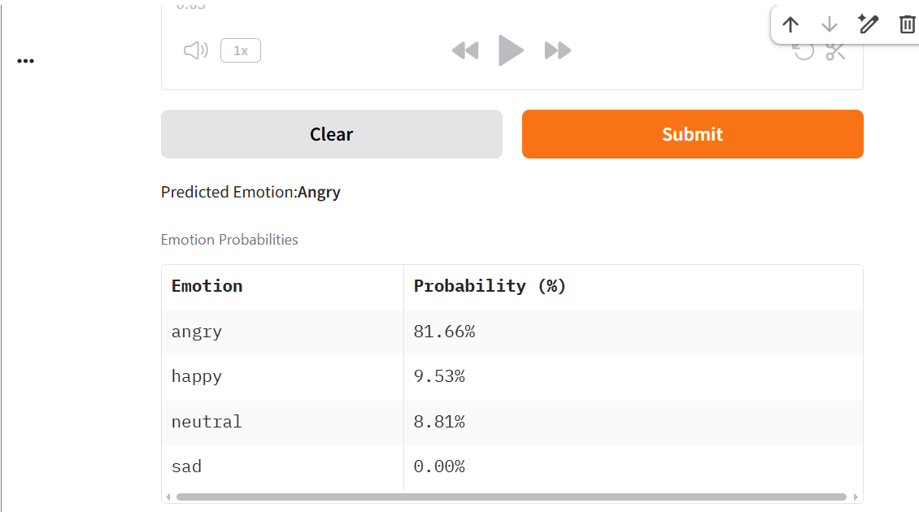
OUTPUTS

Slide 11
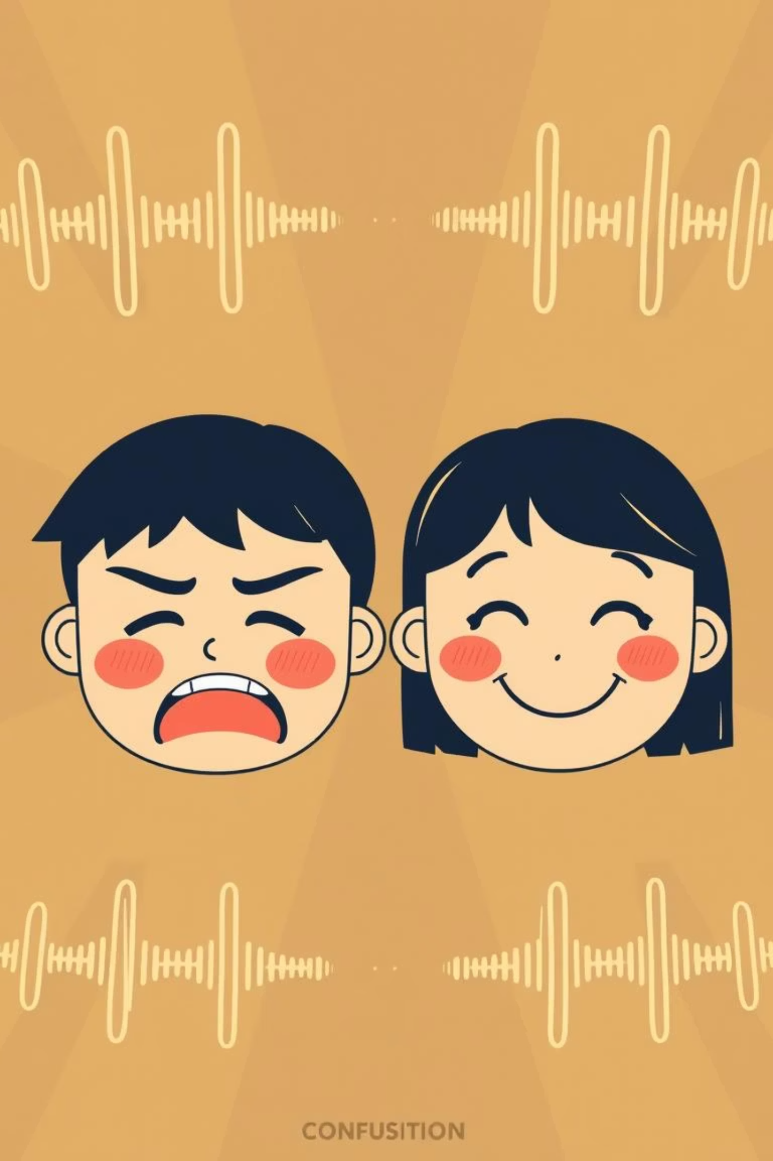



Performance Insights & Challenges
Accuracy Achieved
Common Confusions
Typical models achieve 65-80% accuracy, varying with dataset quality and model architecture.
Anger vs. happy, neutral vs. sad are often confused due to similar acoustic patterns.
Boosting Performance
Data augmentation and multi-feature fusion (e.g., chroma, spectral contrast) are key to improvements.

Slide 12
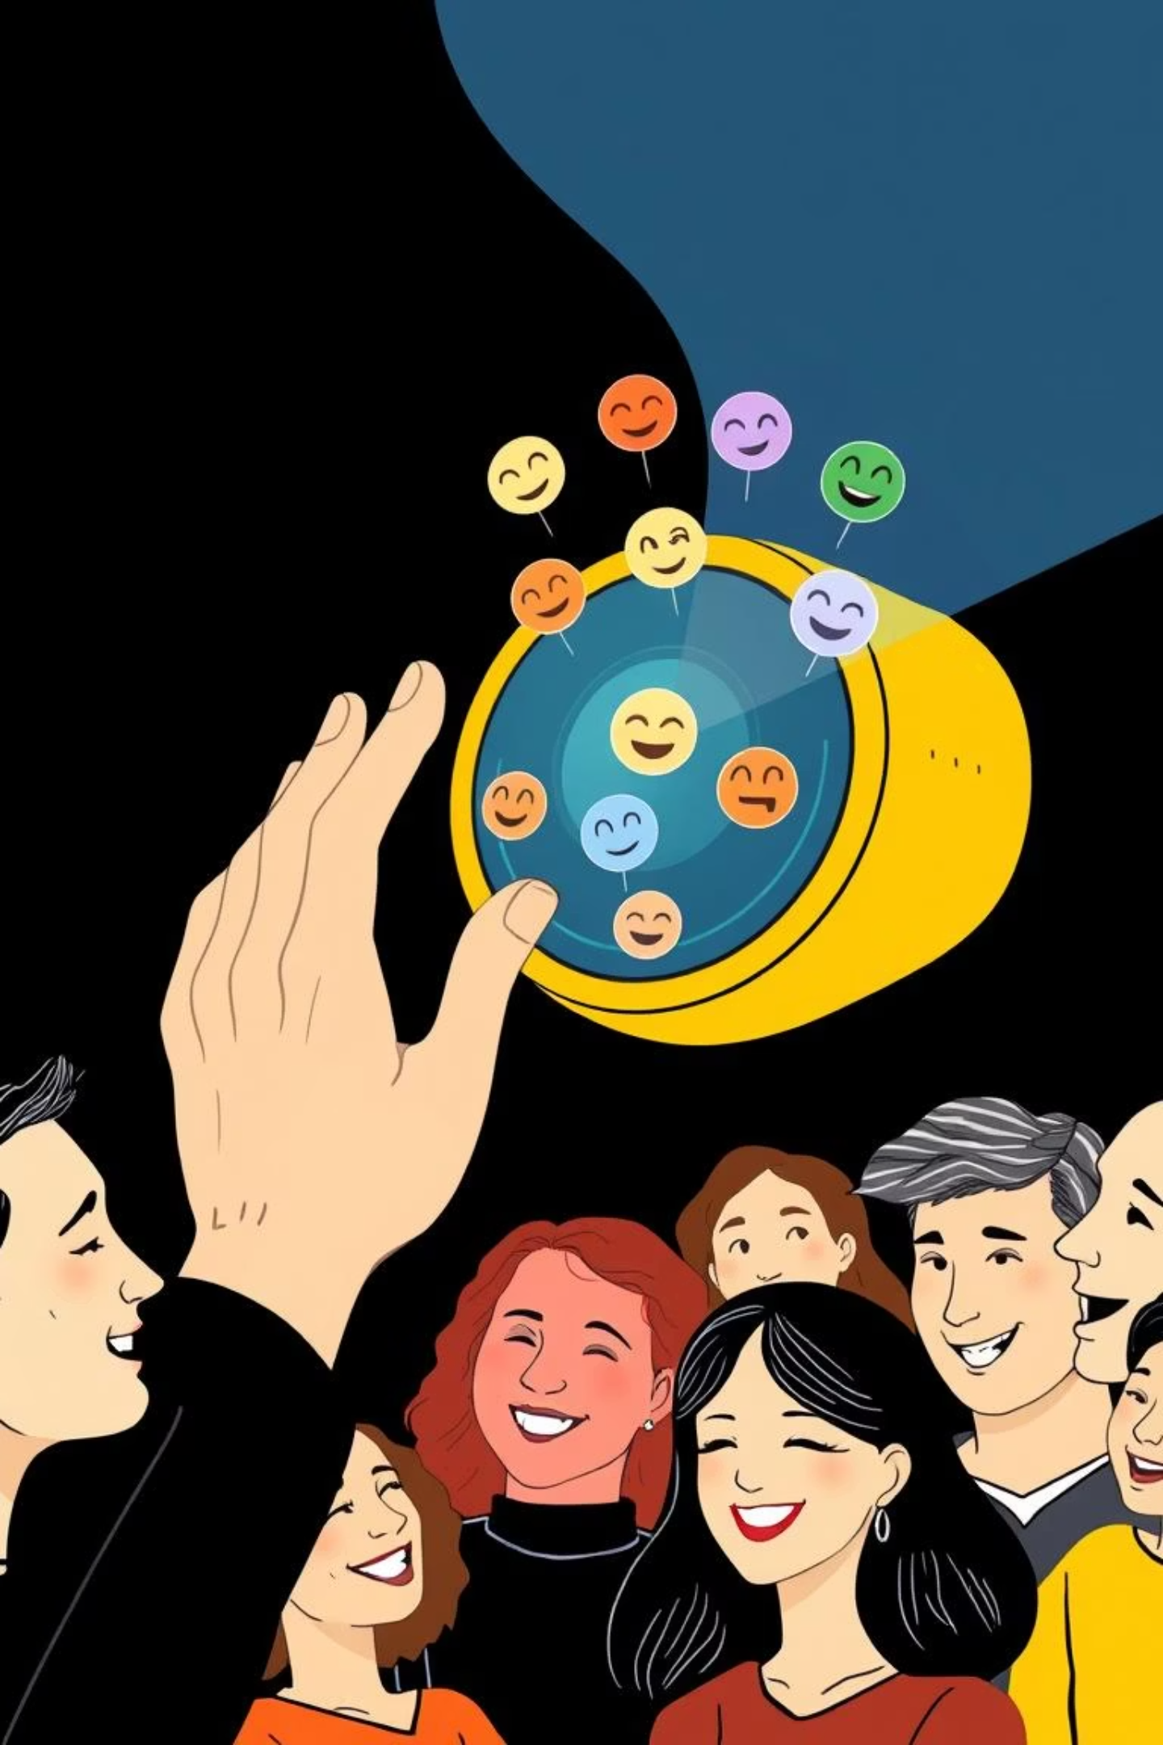

Conclusion & Next Steps
Emotion recognition from speech, leveraging MFCCs and deep learning, offers immense potential across various domains. The combination of CNN and RNN architectures effectively captures both the static and dynamic aspects of emotional speech.
Future Directions
You could emphasize that Hybrid Models (CNN+RNN) are a step towards future success and link the challenge of subtlety to the need for multimodal and robust solutions.
Action Call
Dive into the code and build your own sophisticated emotion recognition system to unlock new possibilities!

